Slide 1
Perception and Image Formation 视觉感知和图像形成
彭小江，博士，副教授
深圳技术大学
邮箱: pengxiaojiang@sztu.edu.cn
主页: https://pengxj.github.io/

Slide 2
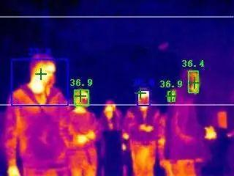
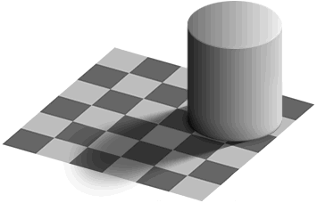

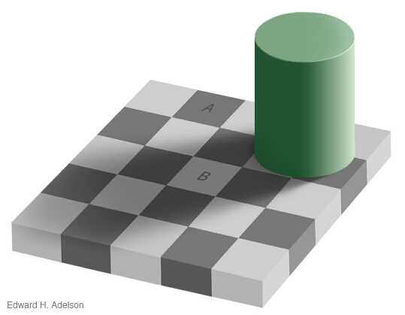
感知：光->视觉
by Ted Adelson
The “white” square B in the shadow and the “black” square A in the light actually have the same absolute intensity value.

Slide 3
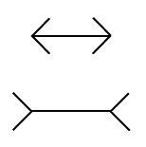
人类视觉感知
The classic Muller-Lyer illusion（缪勒-莱耶尔错觉）, where the length of the two horizontal lines appear different, probably due to the imagined perspective effects（想象透视效应）.

Slide 4
本次课程内容
什么是光
我们如何感知光
生物视觉系统
相机成像原理

Slide 5
光
空间中沿着射线运动的电磁辐射
R(λ) 电磁辐射, 用单位能量描述(瓦特)
λ 是波长

Slide 6
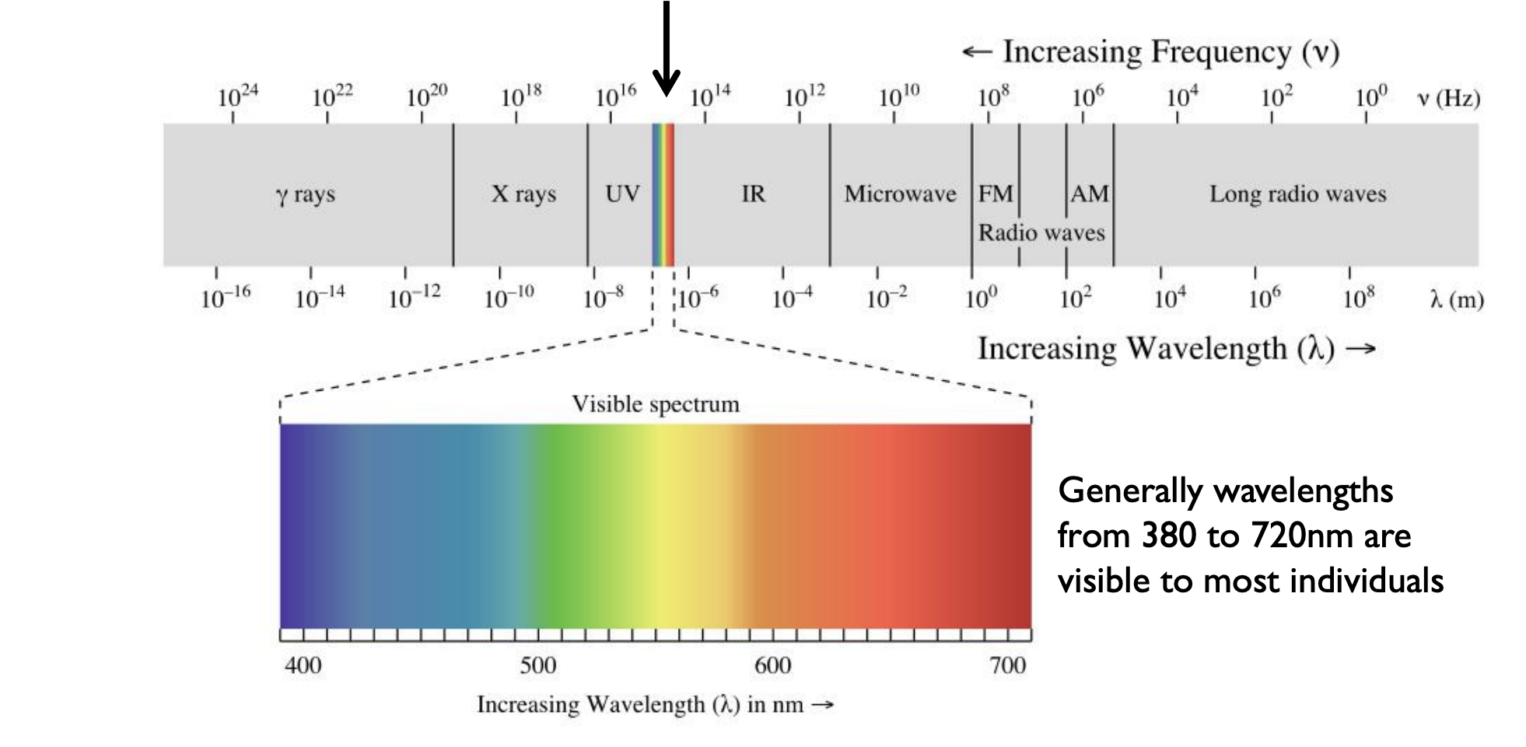
感知光
首先，人类能感知的只有可见光区域

Slide 7
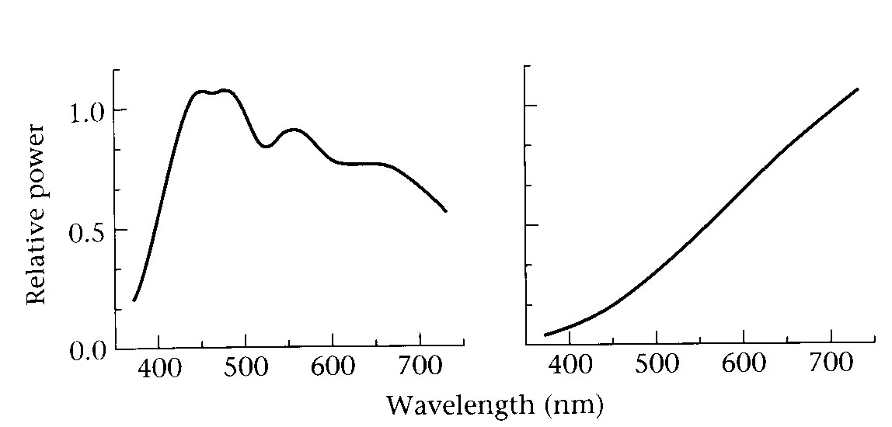
感知光
光的表观（色彩）取决于光谱能量分布
wavelength (nm)
太阳光
白炽灯光

Slide 8
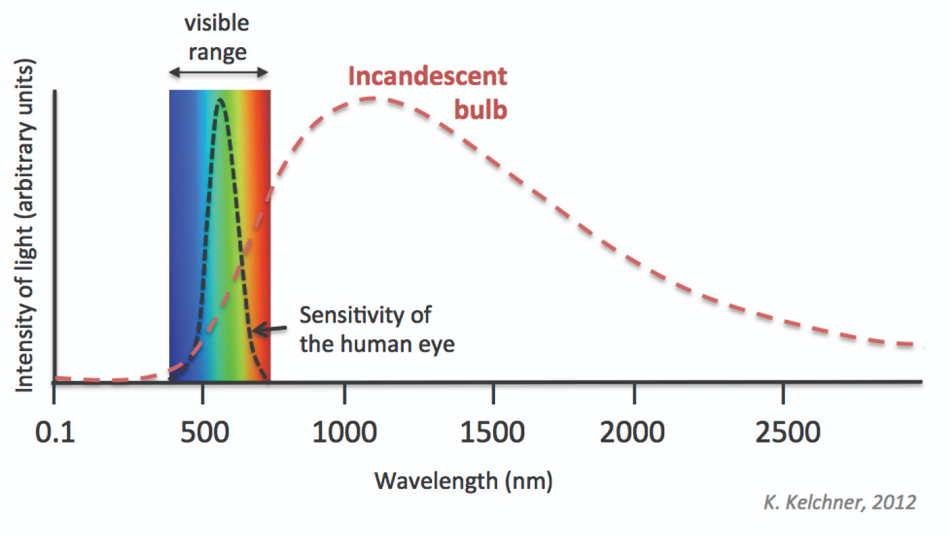
感知光
其次，人类眼睛对不同波长具有不同敏感度
near IR (heat)

Slide 9
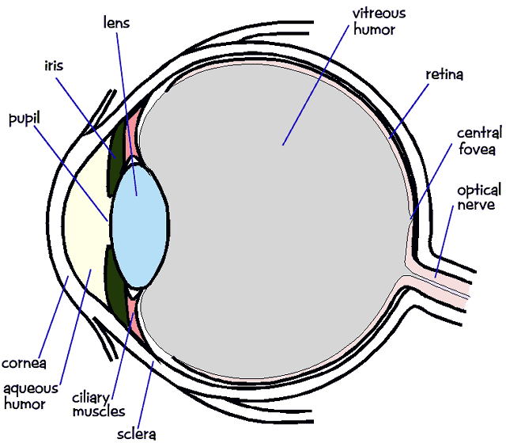
人类视觉系统（人眼）
颜色感知
光透过晶状体（lens）到达视网膜（retina），视网膜有感光细胞，包含三种锥体细胞对应三元色，杆体细胞是暗视器官对弱光反应灵敏，在低照明情况下发生作用，但它不能感受颜色

Slide 10
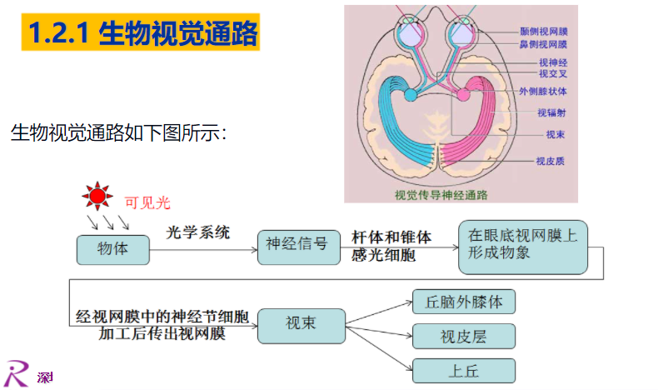
生物视觉系统

Slide 11
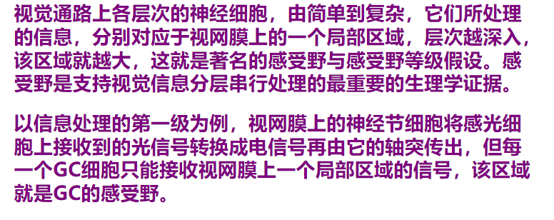
生物视觉系统-感受野分层等级

Slide 12
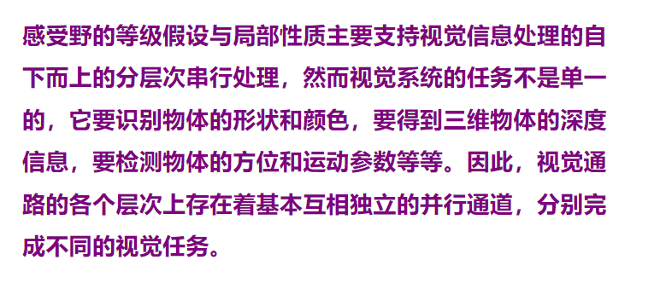
生物视觉系统-视觉信息的并行处理

Slide 13
感知理论
感知的亮度 ~= 光能量

Slide 14
感知理论
感知的亮度 ~= 光能量

Slide 15

光亮对比度
感知的视觉光亮取决于周围区域亮度

Slide 16
明度的恒常性
明度恒常性（Brightness constant）是指当照明条件改变时，人知觉到的物体的相对明度保持不变的知觉特性。
by Ted Adelson

Slide 17
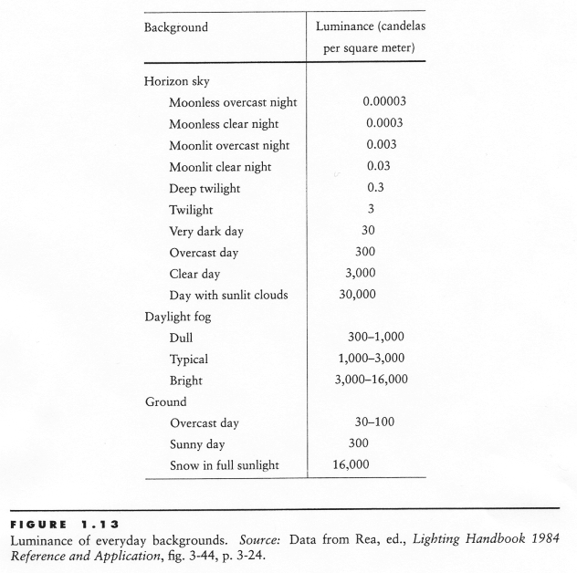
可视动态范围
光强度单位坎德拉

Slide 18
人眼是一个宽动态响应器
人眼可以同时在非常明亮以及在昏暗中看清东西
可能的原因是人眼在对数尺度上感知光
an exponential intensity ramp will be seen as a linear ramp
另一个可能原因是感光神经细胞自适应
锥体细胞和杆体细胞在昏暗环境对光强更加敏感，在高亮时候不太敏感

Slide 19
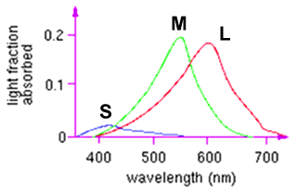
颜色感知
L response curve
三种锥体感光细胞
每种在不同的光谱范围进行响应
but regions overlap
Short (S) corresponds to blue
Medium (M) corresponds to green
Long (L) corresponds to red
不同敏感度: we are more sensitive to green than red
varies from person to person (and with age)
色盲—缺乏其中的一些感光细胞

Slide 20
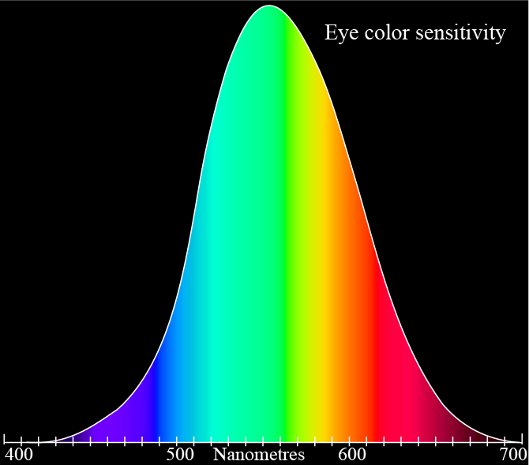
颜色感知

Slide 21
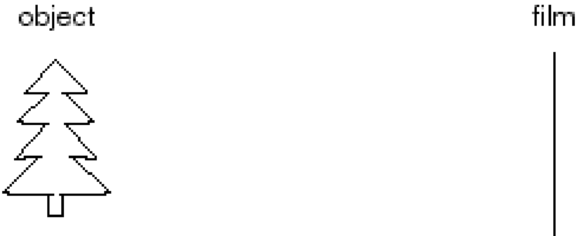
Image formation
Let’s design a camera
Idea 1: put a piece of film in front of an object
Do we get a reasonable image?

Slide 22
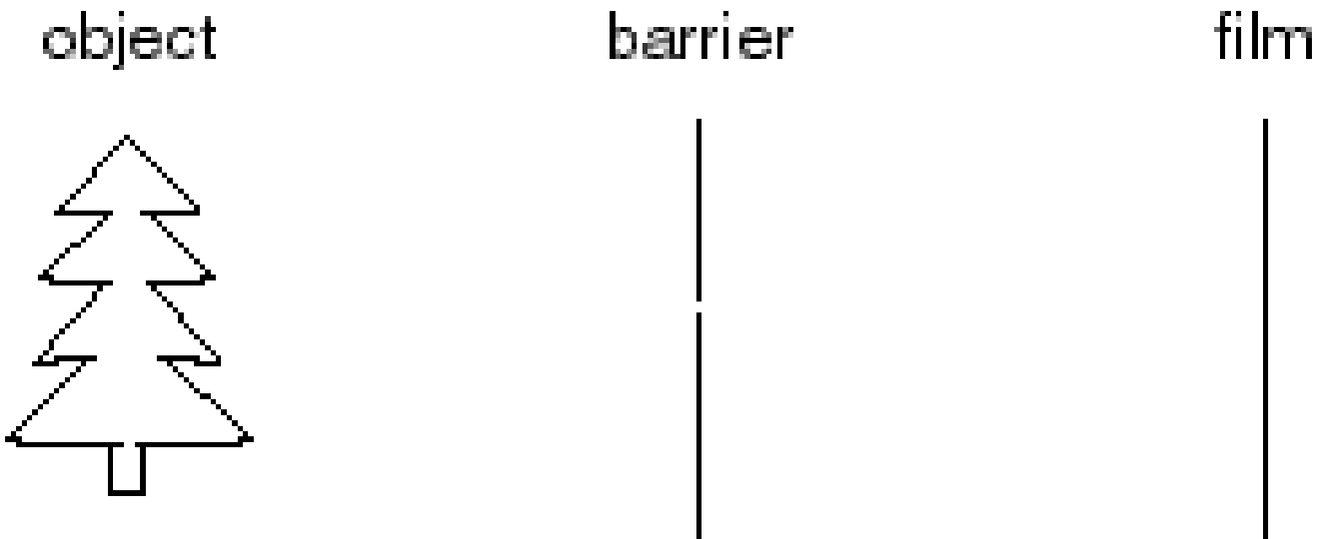
Pinhole camera（小孔相机）
Add a barrier to block off most of the rays
This reduces blurring
The opening known as the aperture
How does this transform the image?

Slide 23
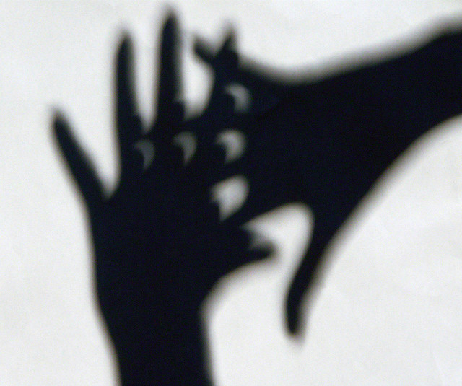
Pinhole cameras everywhere
Sun “shadows” during a solar eclipse（日食）：手指空隙，树荫的缝隙就会成为天然的小孔，对太阳进行成像

Slide 24
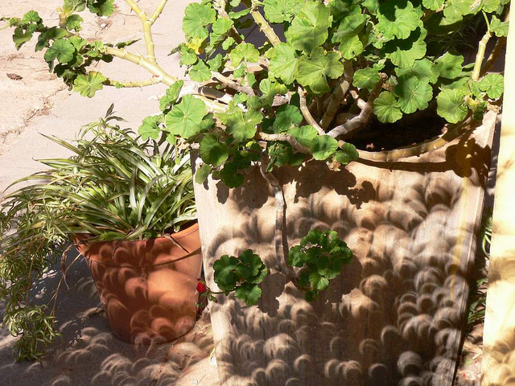
Pinhole cameras everywhere
Sun “shadows” during a solar eclipse http://www.flickr.com/photos/73860948@N08/6678331997/

Slide 25
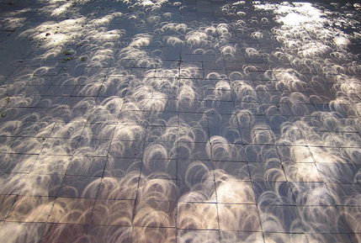
Pinhole cameras everywhere
Tree shadow during a solar eclipse
photo credit: Nils van der Burg http://www.physicstogo.org/index.cfm

Slide 26
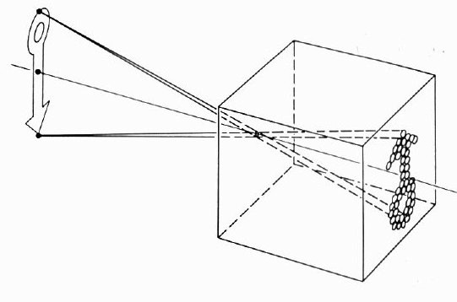
Pinhole Camera (Camera Obscura 暗室)
公元前300 年，希腊学者亚里士多德（Aristote，在他的著作《问题论》（Problemata）中提出早前墨子的成像原理：“如果在一个没有窗户的房子里有一个小孔，小孔对面的墙上有一幅倒转的画面，这个画面就是外面的景象。”
The first camera
Known to Aristotle（亚里士多德）
在世界摄影史上，中国古代先哲墨翟（墨子，约公元前 480 ～ 389）被公认为摄影光学理论和实践的开创者。墨子观察到一个明亮的景物可以通过光束，穿过一个小孔从另一端射出，会在黑暗房间内的对面墙壁上形成倒置的影像

Slide 27
Camera Obscura
The first camera
Known to Aristotle
How does the aperture size（孔径） affect the image?

Slide 28
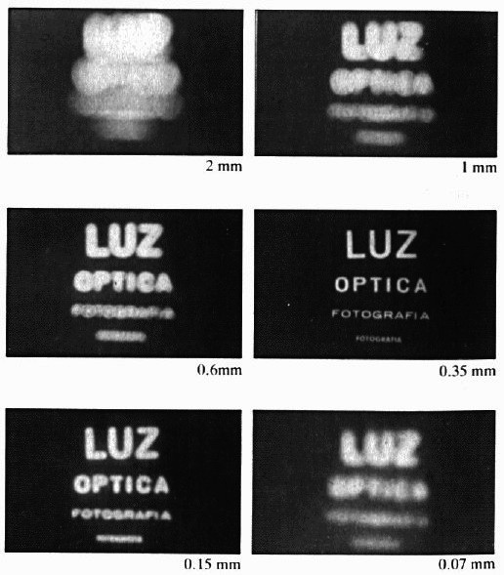
Shrinking the aperture
Why not make the aperture as small as possible?

Slide 29
Shrinking the aperture

Slide 30
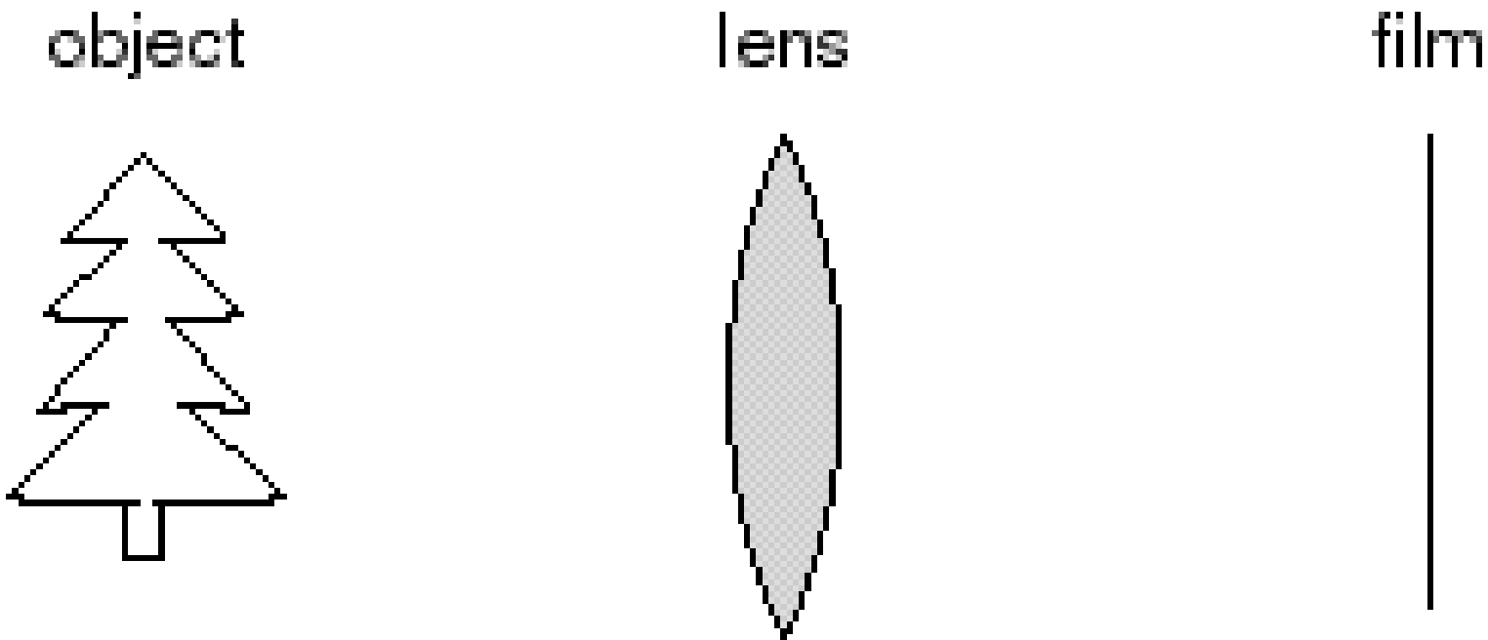
Adding a lens（透镜）
“circle of
confusion”
A lens focuses light onto the film
There is a specific distance at which objects are “in focus”
other points project to a “circle of confusion” in the image
Changing the shape of the lens changes this distance
Notes:
小时候用放大镜烧蚂蚁

Slide 31
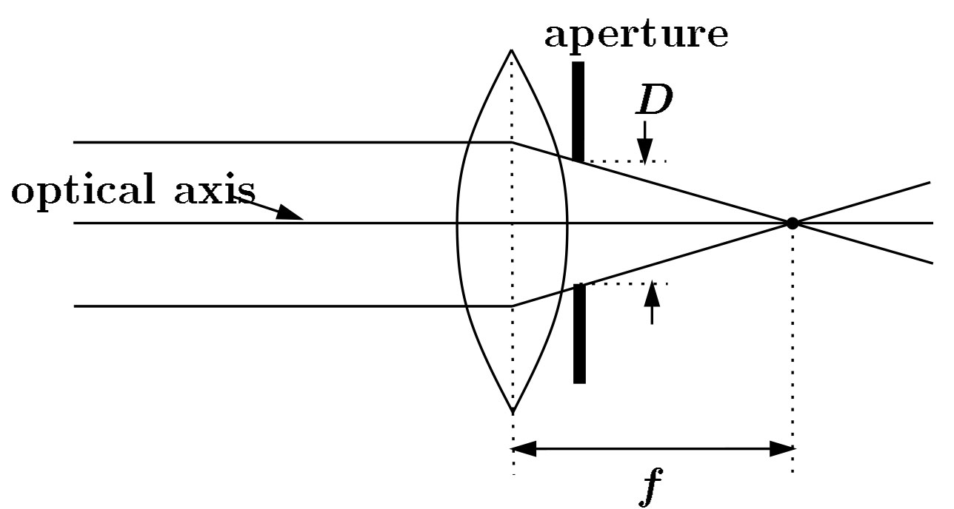
Lenses
光圈孔径
光轴
F
focal point
optical center
(Center Of Projection)
焦距
A lens focuses parallel rays onto a single focal point
focal point at a distance f beyond the plane of the lens
f is a function of the shape and index of refraction of the lens
Aperture of diameter D restricts the range of rays
aperture may be on either side of the lens
Lenses are typically spherical (easier to produce)

Slide 32
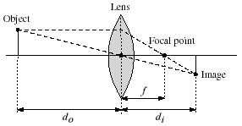
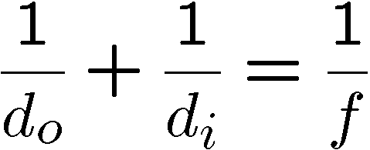
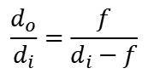
凸透镜成像公式
$$\frac{d_{o}}{d_{i}}=\frac{f}{d_{i}−f}$$
Any object point satisfying this equation is in focus
What is the shape of the focus region?
How can we change the focus region?

Slide 33
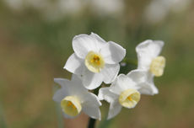
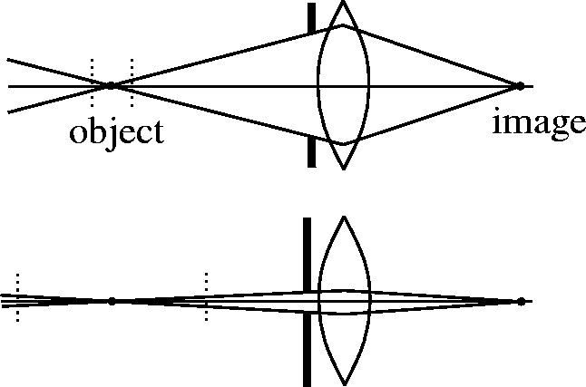
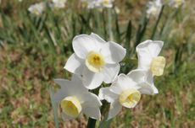
Depth of field（景深）
f / 5.6
f / 32
Changing the aperture size affects depth of field
A smaller aperture increases the range in which the object is approximately in focus
Flower images from Wikipedia http://en.wikipedia.org/wiki/Depth_of_field

Slide 34
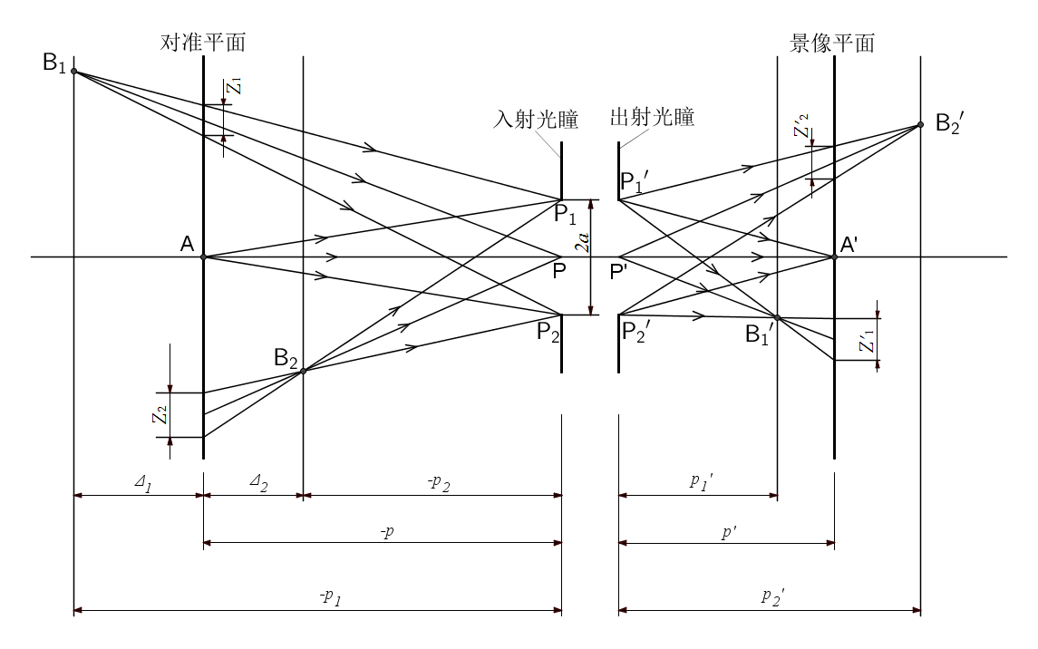
不在对焦平面成像模糊的原理

Slide 35
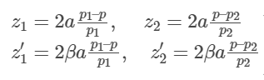
景深和光圈关系
严格上说要精确对焦成像，所有相机都是0景深，但是其实只要模糊斑直径小到分辨不出也算是清晰成像
弥散斑与光圈直径、物距偏移正相关

Slide 36

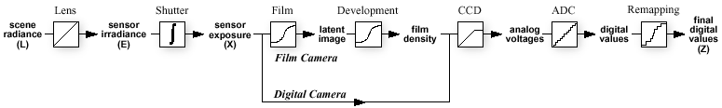
相机对光响应流程（相机成像）
相机如何将场景亮度映射到像素？
It’s also complex, but better understood
This mapping known as the film or camera response function
镜头
快门
电荷转换
给定像素值怎样恢复真实场景亮度/辐射（radiance）?
Why should we care?
Useful if we want to estimate material properties
Shape from shading requires radiance
Enables creating high dynamic range images
What does the response function depend on?

Slide 37
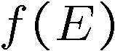

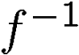
Recovering the camera response
Method 1
Carefully model every step in the pipeline
measure aperture, model film, digitizer, etc.
this is *really* hard to get right
Method 2
Calibrate (estimate) the response function
Image several objects with known radiance
Measure the pixel values
Fit a function
Find the inverse: maps pixel intensity to radiance
pixel intensity
=
response curve
radiance

Slide 38
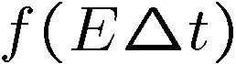
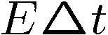
Recovering the camera response
Method 3
Calibrate the response function from several images
Consider taking images with shutter speeds 1/1000, 1/100, 1/10, and 1
Q: What is the relationship between the radiance or pixel values in consecutive images?
A: 10 times as much radiance
Can use this to recover the camera response function
pixel intensity
=
response curve
exposure ≅ radiance * time
=
For more info
P. E. Debevec and J. Malik. Recovering High Dynamic Range Radiance Maps from Photographs. In SIGGRAPH 97, August 1997

Slide 39
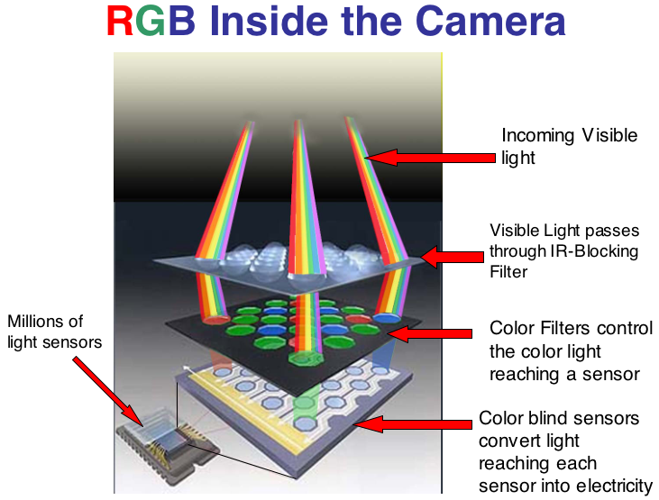
像素值的形成
https://sites.google.com/a/globalsystemsscience.org/digital-earth-watch/tools/digital-cameras-overview/what-happens-to-the-near-infared-entering-the-camera

Slide 40
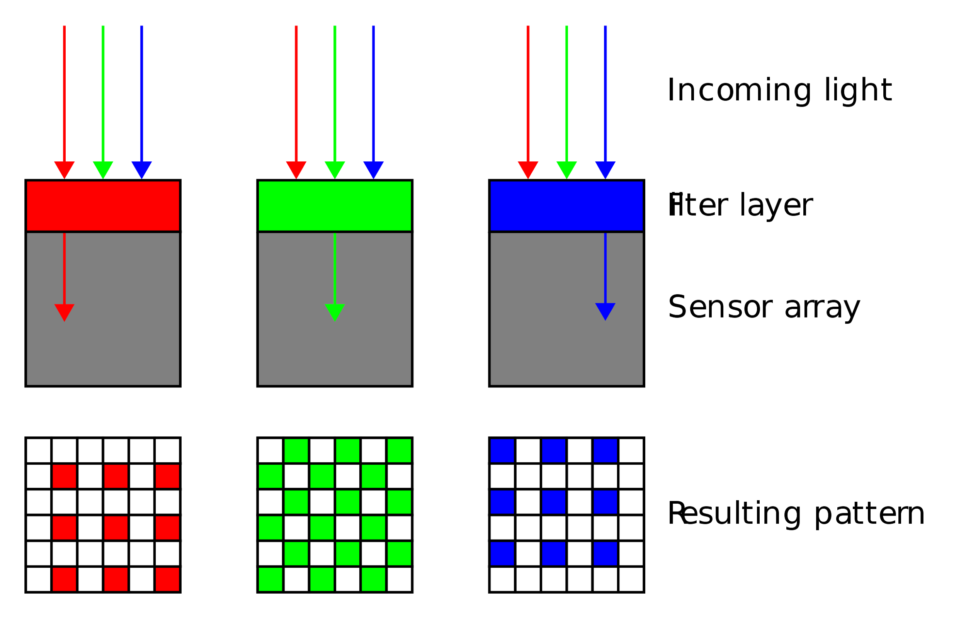
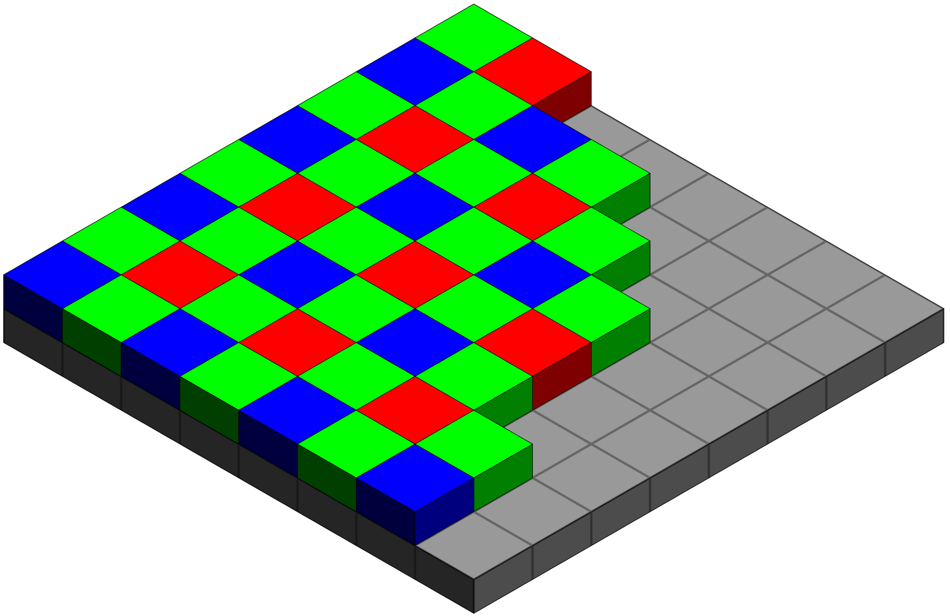
Bayer filters（拜尔滤色镜）
https://en.wikipedia.org/wiki/Bayer_filter
50%是绿色，25%是红色，另外25%是蓝色，因此也称做RGBG
¼ of pixels see red light (e.g.)
Q: how do you get red at every pixel?
A: Need to interpolate -- called debayering

Slide 41
Debayering
100
10
30
50
50
100
10
30
10
¼ of pixels see red light (e.g.)
Q: how do you get red at every pixel?
A: Need to interpolate -- called debayering

Slide 42
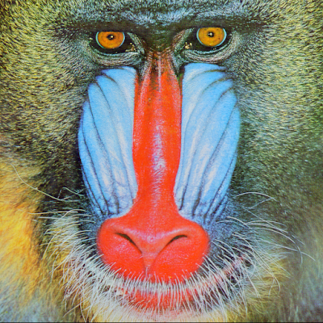
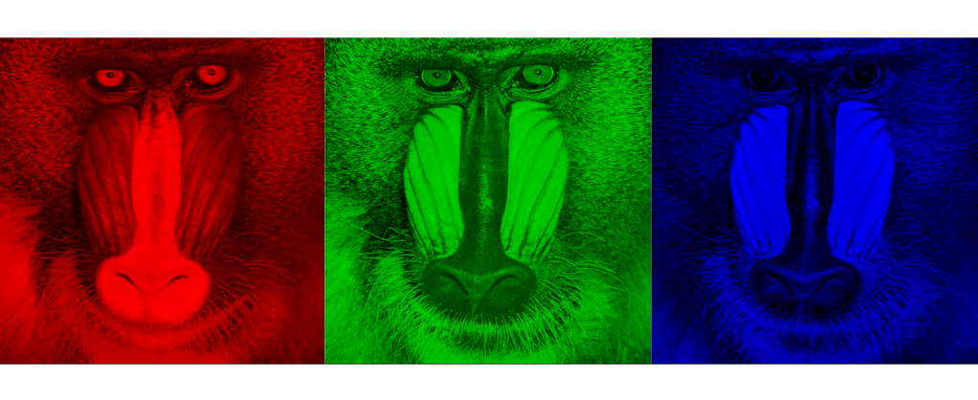
RGB images (three channel)
what we see
What we get out of the camera

Slide 43
Ex2: 初识OpenCV
1.下载安装opencv 3, （编译带python API的版本）
2. 用C++和Python分别进行图像读取修改保存
3. 选定ROI区域进行抠图等
4. 在图片中画矩形、圆形、直线、文字
import cv2
Lena = cv2.imread(“lena.bmp”)
参考：https://docs.opencv.org/3.0-beta/

